Slide 1

WARMLY WELCOME TEACHERS TO OUR CLASS
Nhu Quynh Secondary School
Teacher: Nguyen Thi Lu

Slide 2
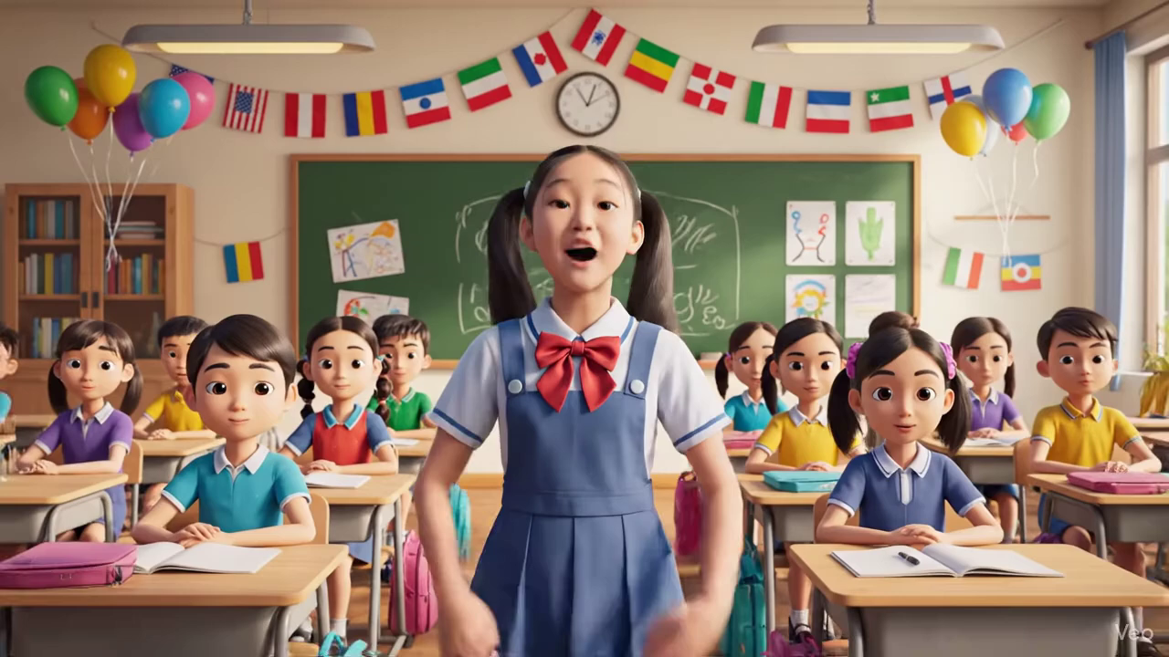

Slide 3

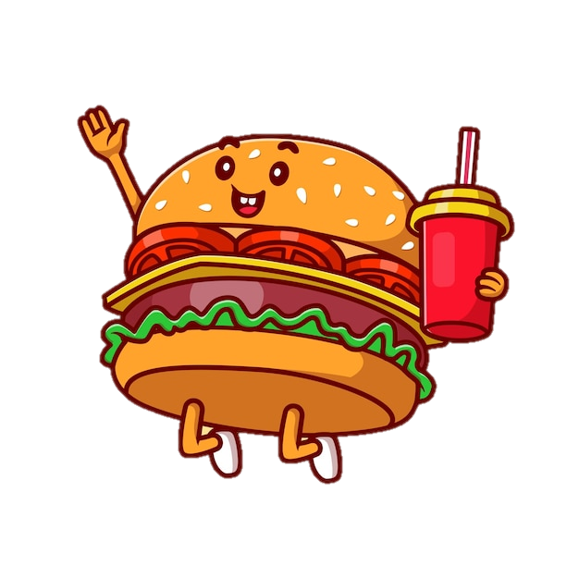
/fʊt/ /fuːd/
foot
food
What are the sounds?

Slide 4
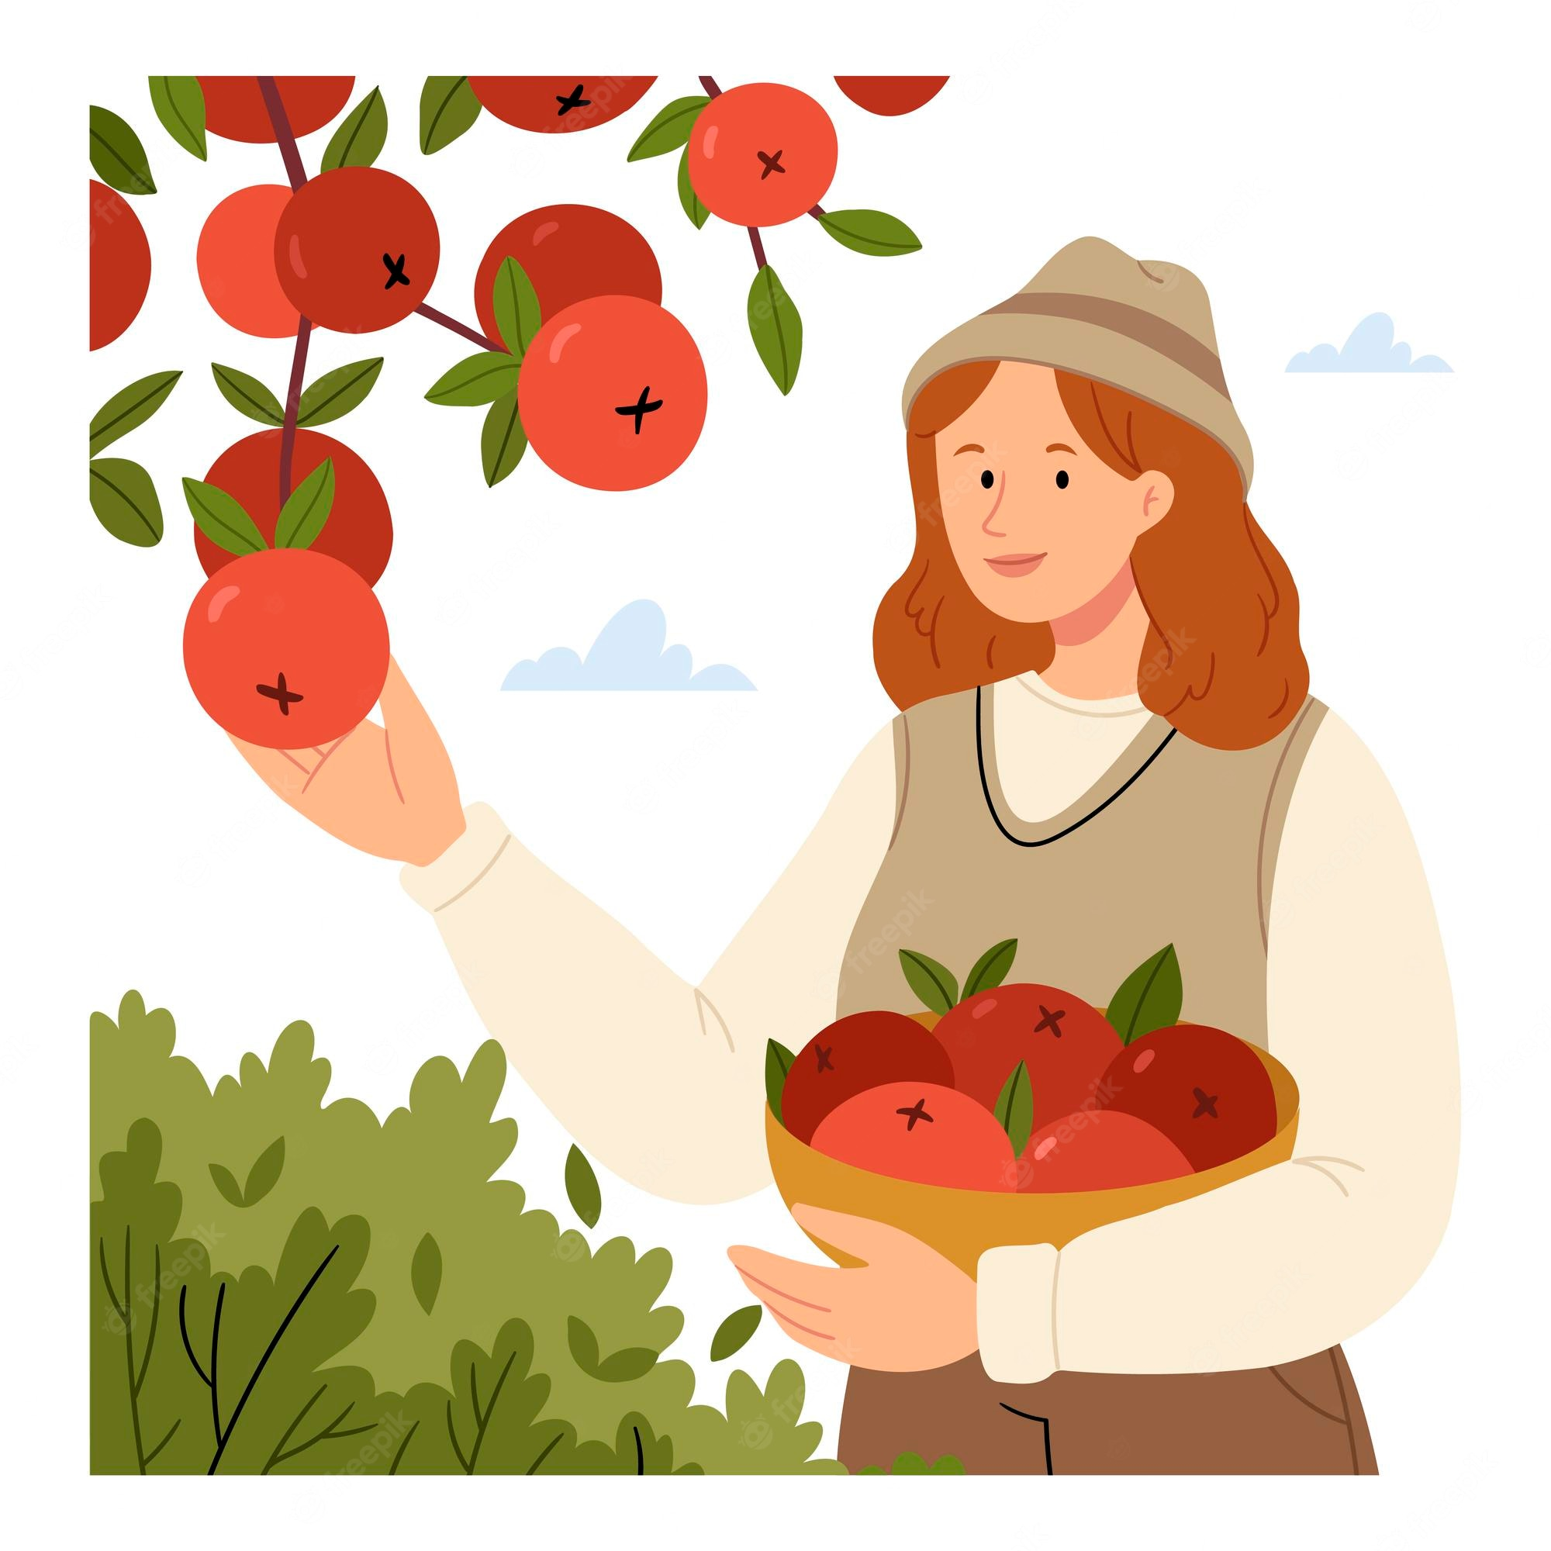
What are they doing?
What are the sounds?
collect
collect
pick
pick
/ə/
/ɪ/

Slide 5
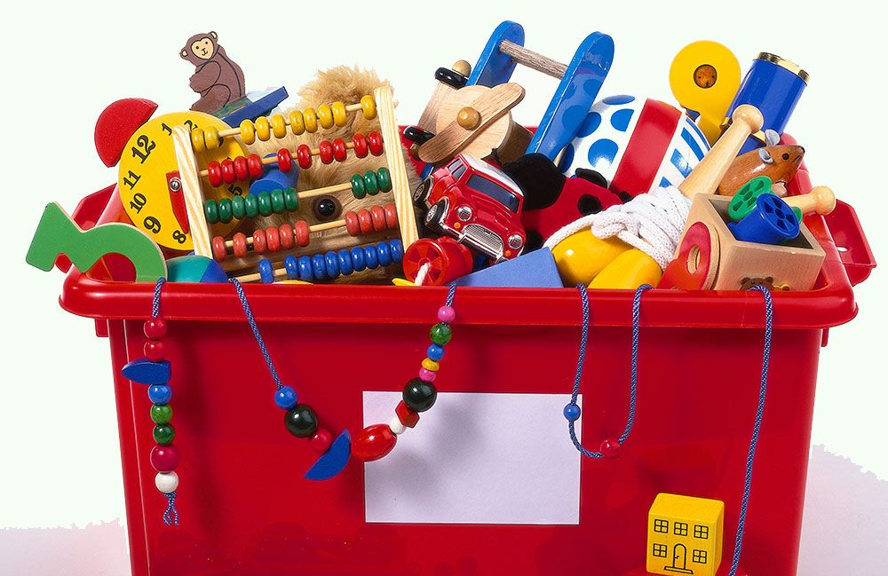

How can you pronounce?
toy
/tɔɪ/
tourist
/ˈtʊərɪst/

Slide 6
REVIEW 1
Tuesday, October 28th 2025
Period 23/Lesson 1: Language

Slide 7

I. Pronuciation
review pairs of sounds /ʊ/ and /u:/, /ə/ and /ɪ/, and /ʊə/ and /ɔɪ/ in Units 1 - 3

Slide 8
I. Circle the word whose underlined part is pronounced differently from the others. (Ex1/P38)
1. A. good B. cool C. foot D. cook
2. A. June B. rude C. truth D. put
3. A. village B. buffalo C. cottage D. shortage
4. A. ensure B. insure C. picture D. surely
5. A. avoid B. doing C. choice D. join

Slide 9

I. Circle the word whose underlined part is pronounced differently from the others. (Ex1/P38)
1. A. good B. cool C. foot D. cook
/ɡʊd/ /kuːl/ /fʊt/ /kʊk/
2. A. June B. rude C. truth D. put
/dʒuːn/ /ruːd/ /truːθ/ /pʊt/
3. A. village B. buffalo C. cottage D. shortage
/ˈvɪl.ɪdʒ/ /ˈbʌf.ə.ləʊ/ /ˈkɒt.ɪdʒ/ /ˈʃɔː.tɪdʒ/
4. A. ensure B. insure C. picture D. surely
/ɪnˈʃʊər/ /ɪnˈʃʊər/ /ˈpɪk.tʃər/ /ˈʃʊəli/
5. A. avoid B. doing C. choice D. join
/əˈvɔɪd/ /ˈduː.ɪŋ/ /tʃɔɪs/ /dʒɔɪn/

Slide 10


LIKE OR DISLIKE?
love
like
detest
fancy
dislike
enjoy
hate
prefer
be interested in
be into
be keen on
be fond of
love
like
enjoy
be keen on
detest
dislike
prefer
be fond of
be into
hate
fancy
be interested in

Slide 11

II. Vocabulary

Slide 12
I. Circle the correct answer A, B, or C to complete each sentence. (Ex2/P38)
1. Mi is ______ gardening in her free time.
A. in B. into C. to
2. Mai is interested ______ building websites for her friends.
A. of B. with C. in
3. Minh is not fond of ______ puzzles because he thinks it takes a lot of time.
A. making B. doing C. building
4. I’m not keen on ______ our class photos to the forum.
A. uploading B. surfing C. messaging
5. While I was ______ some websites, I saw an advertisement about a resort.
A. creating B. browsing C. uploading

Slide 13
I. Circle the correct answer A, B, or C to complete each sentence. (Ex2/P38)
1. Mi is ______ gardening in her free time.
A. in B. into C. to
2. Mai is interested ______ building websites for her friends.
A. of B. with C. in
3. Minh is not fond of ______ puzzles because he thinks it takes a lot of time.
A. making B. doing C. building
4. I’m not keen on ______ our class photos to the forum.
A. uploading B. surfing C. messaging
5. While I was ______ some websites, I saw an advertisement about a resort.
A. creating B. browsing C. uploading
be into something: to like and be interested in something
interested in: wanting to give your attention to something and discover more about it
doing puzzles: làm câu đố
uploading: đăng tải
surfing: lướt
messaging: nhắn tin
creating: tạo ra
browsing: duyệt
uploading: đăng tải

Slide 14
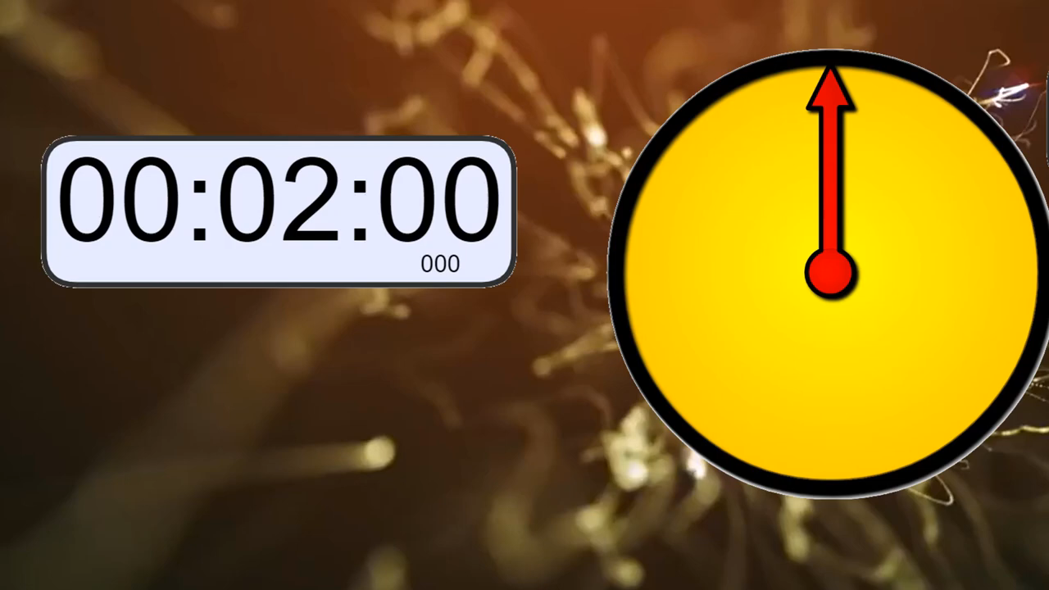
Jumbled words
1. byllu
bully
2. tainred
trained
3. hoblespita
hospitable
4. preursse
pressure
5. cusfo
focus

Slide 15
2. Complete the sentences with the words from the box. (Ex3/P38)
bully trained hospitable pressure focus
1. People in my village are very ________ to all visitors.
2. Parents in our village don’t put much _______ on their children to do well at school.
3. In my school, we can ____ on study and play, and do not have to worry about bullies.
4. The best ______ player in our chess club will not be able to join the competition.
5. If a boy uses his strength to frighten weaker peers, he is a ____.

Slide 16
2. Complete the sentences with the words from the box. (Ex3/P38)
bully trained hospitable pressure focus
1. People in my village are very ________ to all visitors.
2. Parents in our village don’t put much _______ on their children to do well at school.
3. In my school, we can ____ on study and play, and do not have to worry about bullies.
4. The best ______ player in our chess club will not be able to join the competition.
5. If a boy uses his strength to frighten weaker peers, he is a ____.
hospitable
pressure
focus
trained
bully

Slide 17
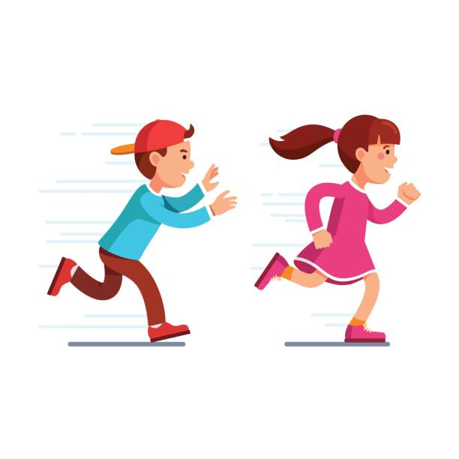
The girl runs faster than the boy.
The girl runs faster than the boy.
comparative form
short adv
short adv + er

Slide 18
The boy runs more slowly than the girl.
The boy runs more slowly than the girl.
comparative form
long adv
more + long adv

Slide 19

III. GRAMMAR

Slide 20
1. Choose the correct answer A, B, or C. (Ex4/P38)
1. Mai dislikes ______ her pictures to Facebook. She prefers not to show them to others.
A. to upload B. uploading C. upload
2. We enjoy ______ photos of different types of scenery, so we took a camera with us.
A. taking B. to take C. take
3. She did the puzzles ______ than I did, so I won the competition.
A. slowly B. slower C. more slowly
4. Tom worked ______ than Mi; therefore, he got better results in the exams.
A. hardly B. harder C. more hard
5. Now they all chat with each other ______ than before because they have smartphones.
A. more frequently B. frequent C. frequently

Slide 21
1. Choose the correct answer A, B, or C. (Ex4/P38)
1. Mai dislikes ______ her pictures to Facebook. She prefers not to show them to others.
A. to upload B. uploading C. upload
2. We enjoy ______ photos of different types of scenery, so we took a camera with us.
A. taking B. to take C. take
3. She did the puzzles ______ than I did, so I won the competition.
A. slowly B. slower C. more slowly
4. Tom worked ______ than Mi; therefore, he got better results in the exams.
A. hardly B. harder C. more hard
5. Now they all chat with each other ______ than before because they have smartphones.
A. more frequently B. frequent C. frequently
dislike doing something: to think something is unpleasant and not like them
enjoy doing something: to get pleasure from something
trạng từ “slowly” bổ nghĩa cho động từ “did”
so sánh hơn “more … than”
so sánh hơn: hard ➝ harder
so sánh hơn “more … than”

Slide 22
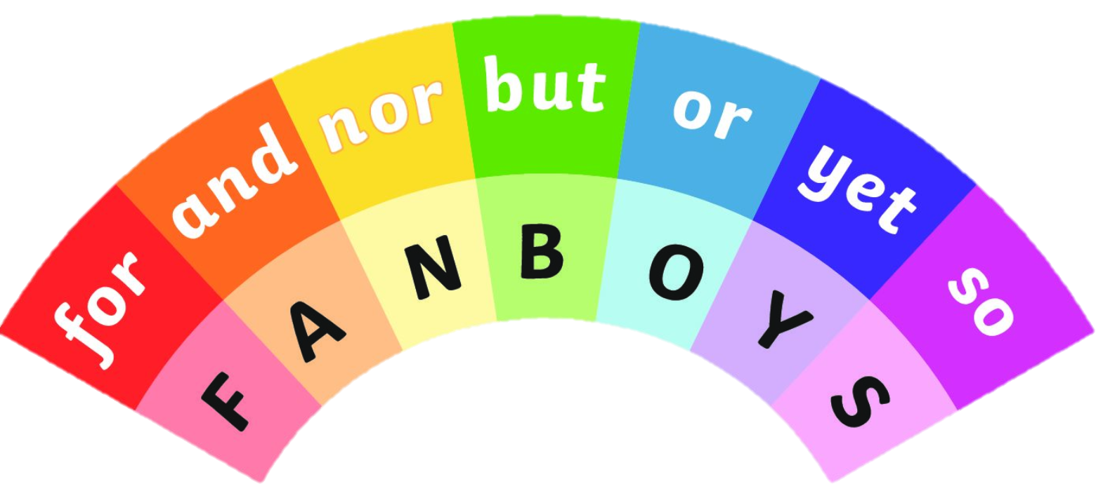
We can use a coordinating conjunction: for, and, but, or, so to join in independent clauses.
nhưng
và không
hoặc
và
nhưng
vì
thế nên

Slide 23
We can use a conjunctive adverb: however,
therefore, otherwise to join in independent clauses.
…; therefore,…: thế nên
…; however,…: tuy nhiên
…; otherwise,…: nếu không thì

Slide 24
2. Underline the correct bold word in each sentence. (Ex5/P38)
1. Minh is interested in painting, so / but yesterday he decided to join the arts and crafts club.
2. Life in the city seems to be more comfortable, otherwise / but I prefer life in the countryside.
3. She tries to focus more on her studies; therefore / otherwise, she won’t pass her exams.
4. During harvest time, farmers have to get up earlier, and / so they have to work harder.
5. Parents now have higher expectations of their children; therefore / so, children are under more pressure than before.

Slide 25
2. Underline the correct bold word in each sentence. (Ex5/P38)
1. Minh is interested in painting, so / but yesterday he decided to join the arts and crafts club.
2. Life in the city seems to be more comfortable, otherwise / but I prefer life in the countryside.
3. She tries to focus more on her studies; therefore / otherwise, she won’t pass her exams.
4. During harvest time, farmers have to get up earlier, and / so they have to work harder.
5. Parents now have higher expectations of their children; therefore / so, children are under more pressure than before.
so
but
otherwise
and
therefore

Slide 26


homework
- Do exercise in workbook.
- Prepare for the next lesson: Review (SKILLS).

Slide 27

Thank you do you have any question?

